Slide 1

SUPER STORE Sales Dashboard
Group 1
Komal jain
Shruti daoo

Slide 2
Types of Visualization
Filter
Parameters with Sets
Profit Forecasting
Running Total
KPIs
Presentation Title

Slide 3
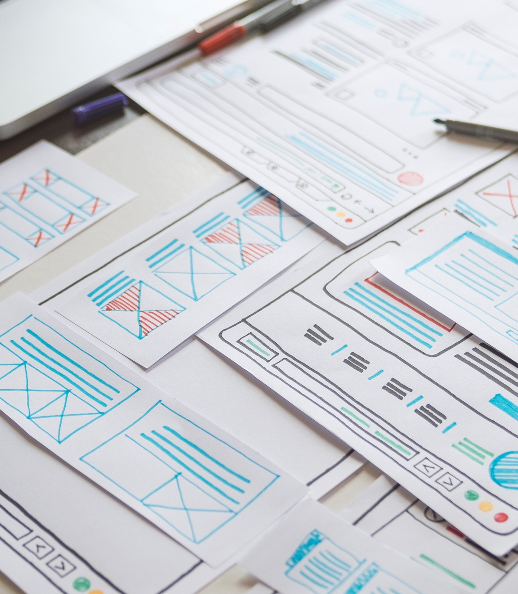
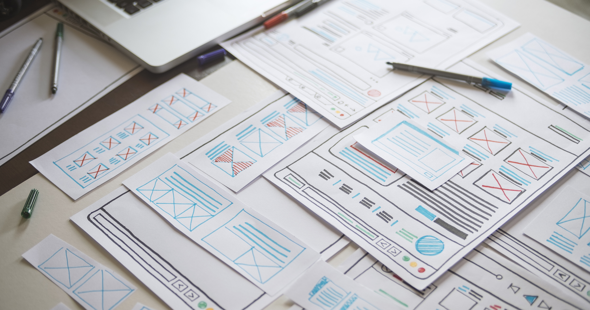
Primary goals
When to use what

Slide 4

Introduction
Visualization is the process of creating representations to understand information, ideas, or concepts.
Visualization is picturing data in graphs, imagining a story unfolding. It's a powerful tool that can enhance creativity, problem-solving, and overall understanding.

Slide 5
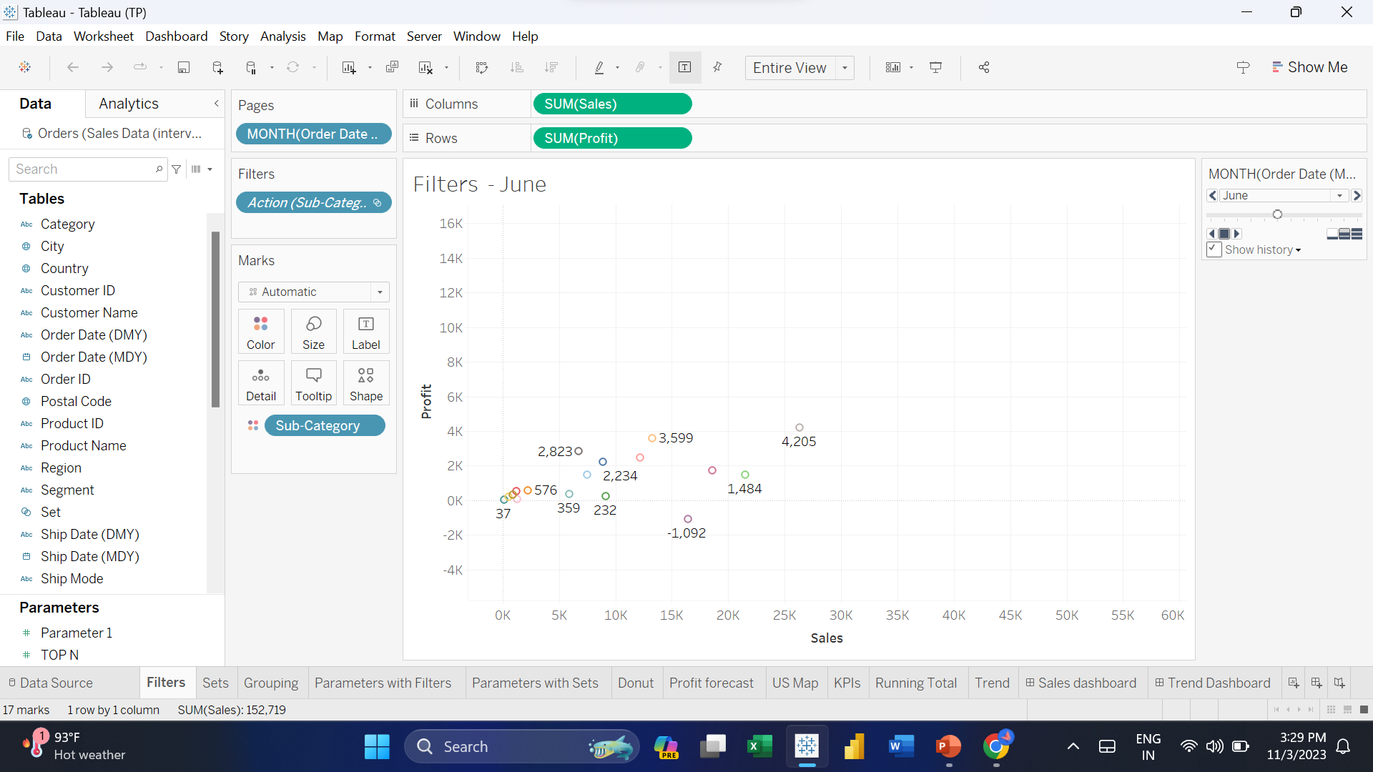
A cascading filter, also known as dependent or hierarchical filter, is a type of filter setup where the choices in one filter dynamically changes the options available in another. It's like a chain reaction where selecting an option in the first filter updates the options in the subsequent filters.

Slide 6
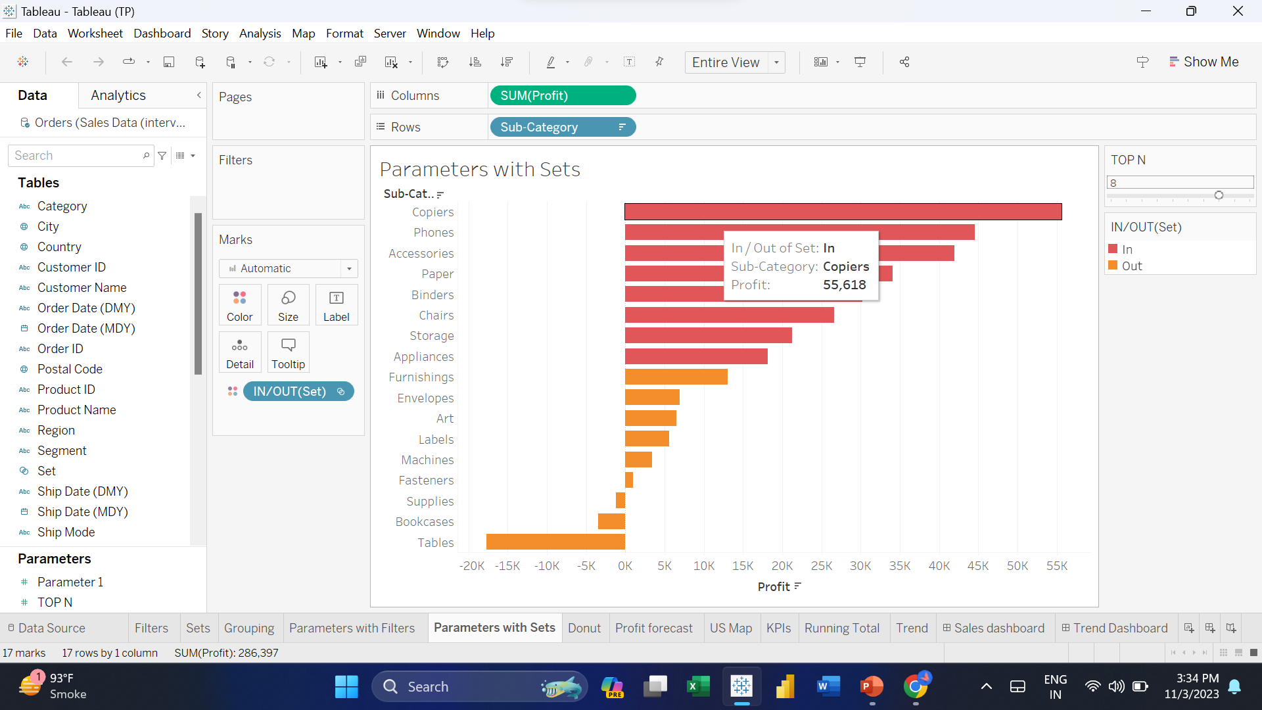
Parameters with sets is a powerful technique that adds flexibility and interactivity to your visualizations.

Slide 7
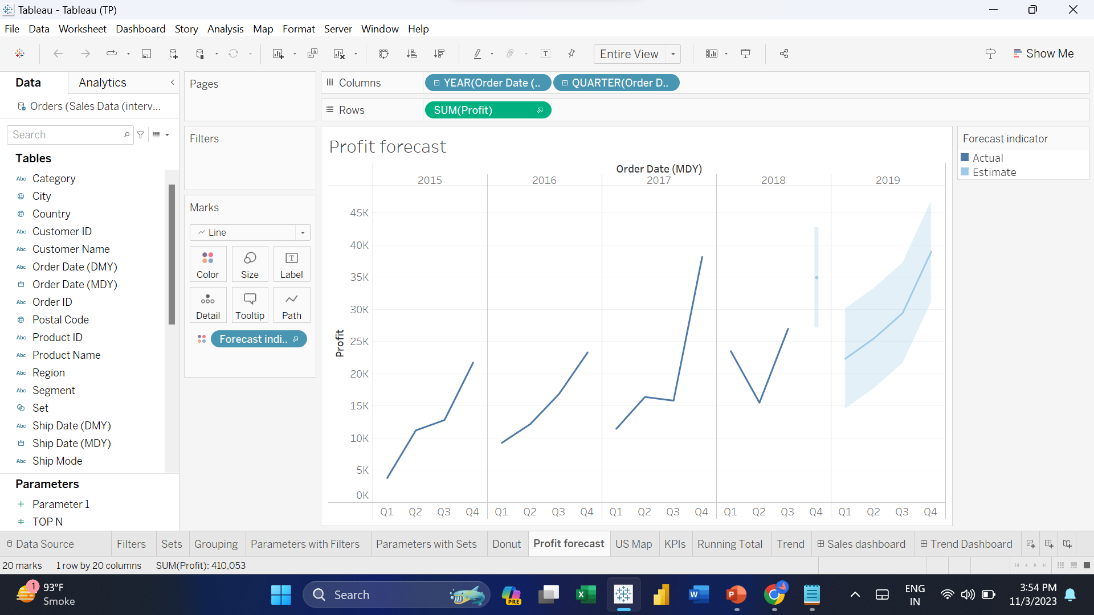
Profit forecasts can be beneficial in various business scenarios to provide valuable insights and aid in decision-making.

Slide 8
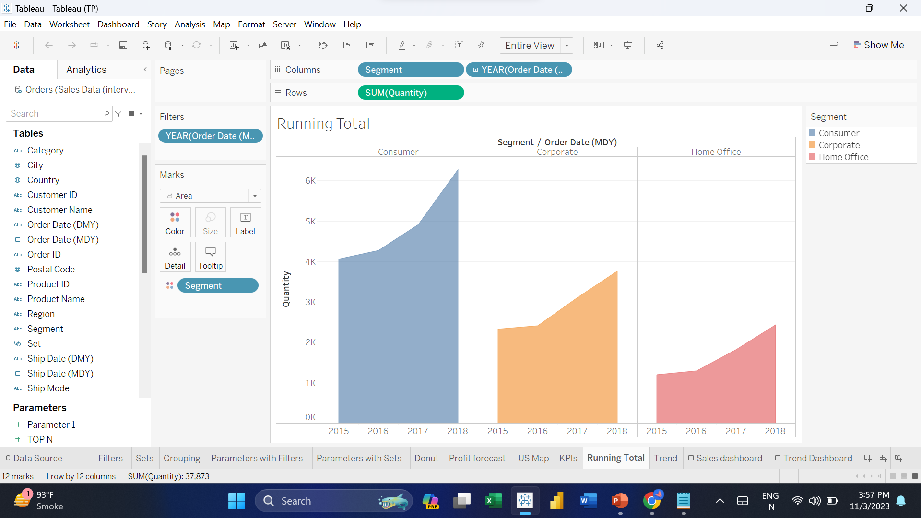
Running Total is used to track the cumulative sum or running sum of a particular measure over a sequential order or specific dimension.

Slide 9
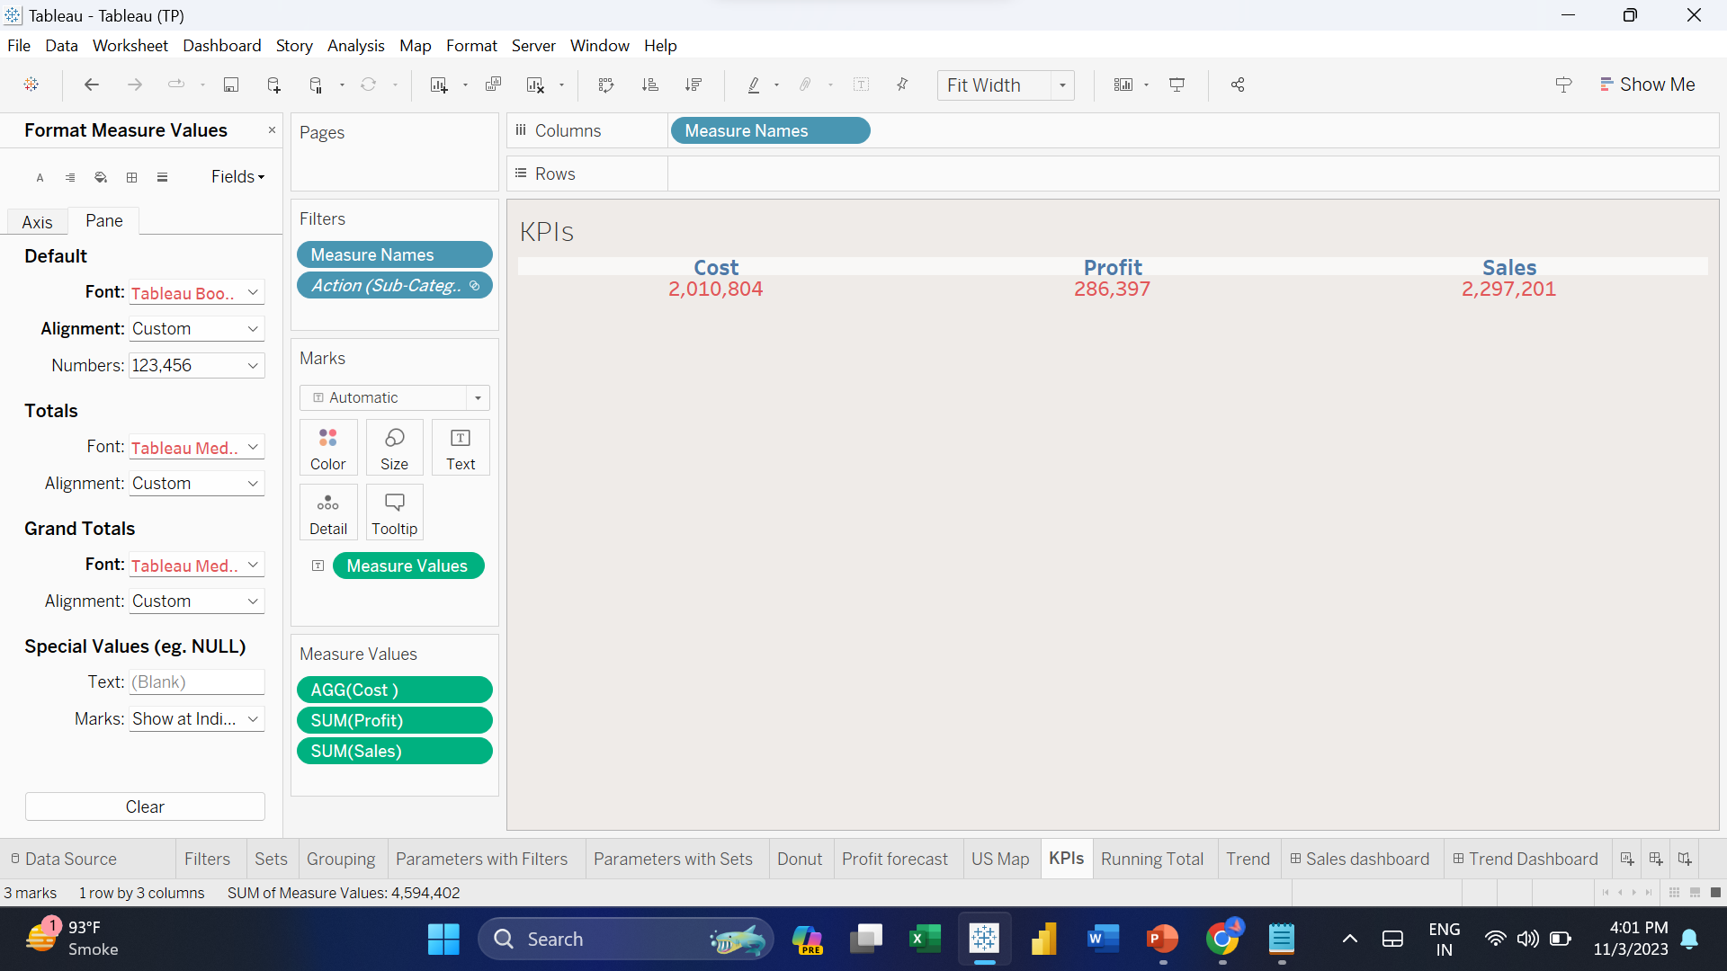
Key Performance Indicators (KPIs) are useful in a variety of business scenarios to measure the success of an organization, project, or specific activities.

Slide 10
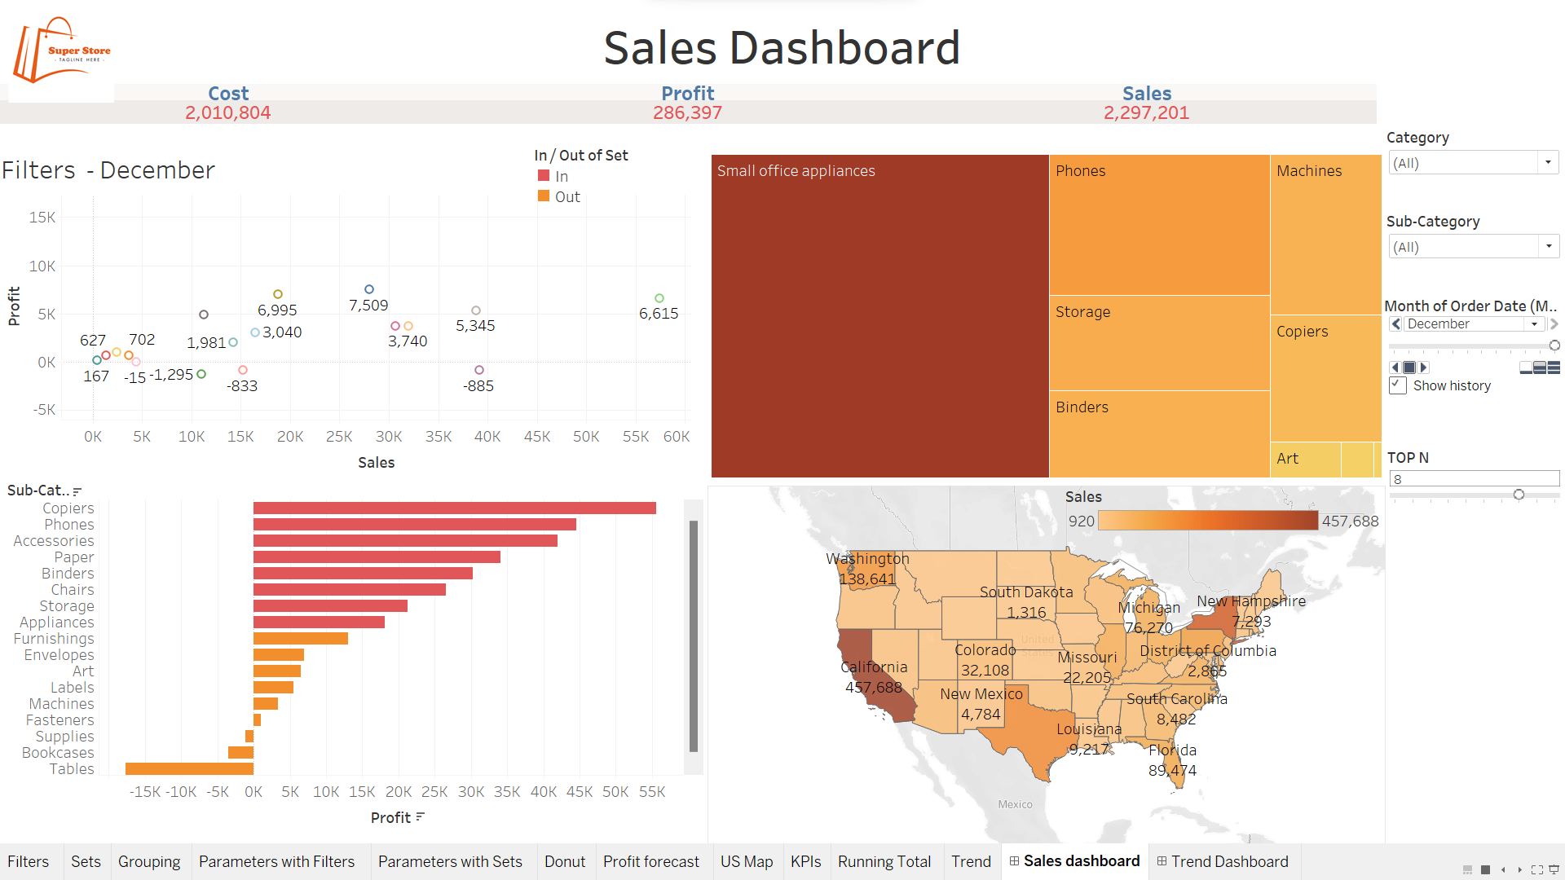

Slide 11


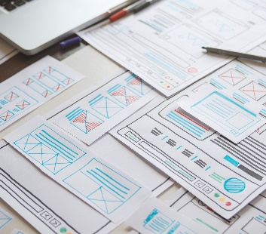

Thank you

